Slide 1

GaN/AlGaN heterostructure
2DEG Length $1 μm$
Simulated Frequency 25 THz

Slide 2
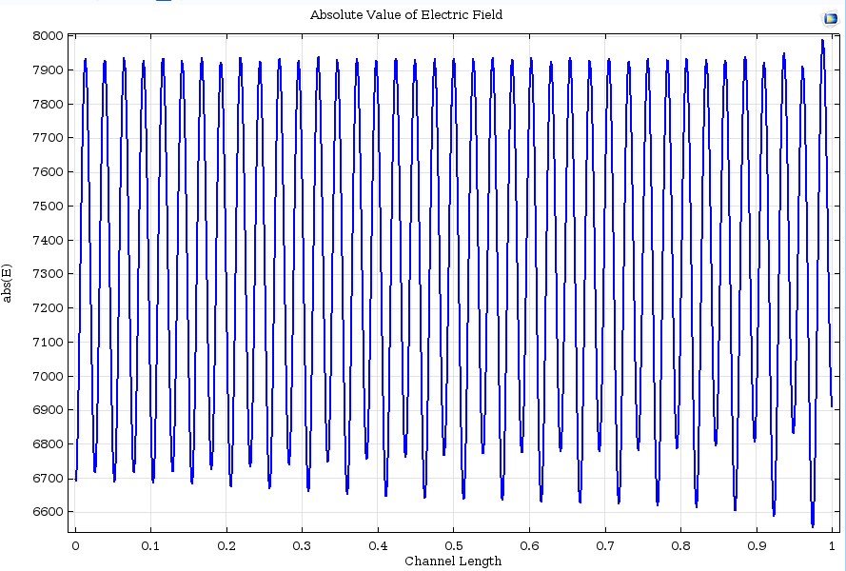
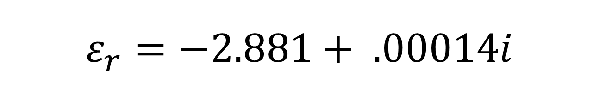
$$ε_{r}=−2.881+ .00014i$$

Slide 3
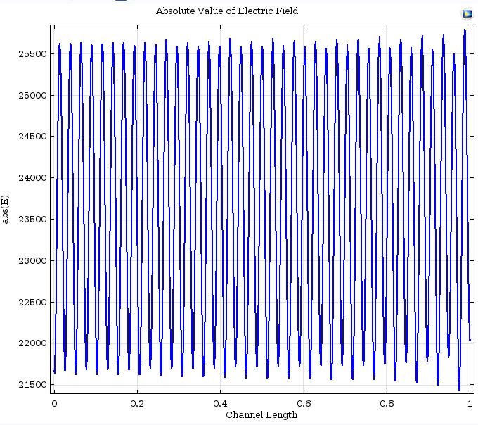
$$ε_{r}=−2.881+ .00014i$$
Extra Plane wave source with E-field polarization along the 2DEG.

